Slide 1
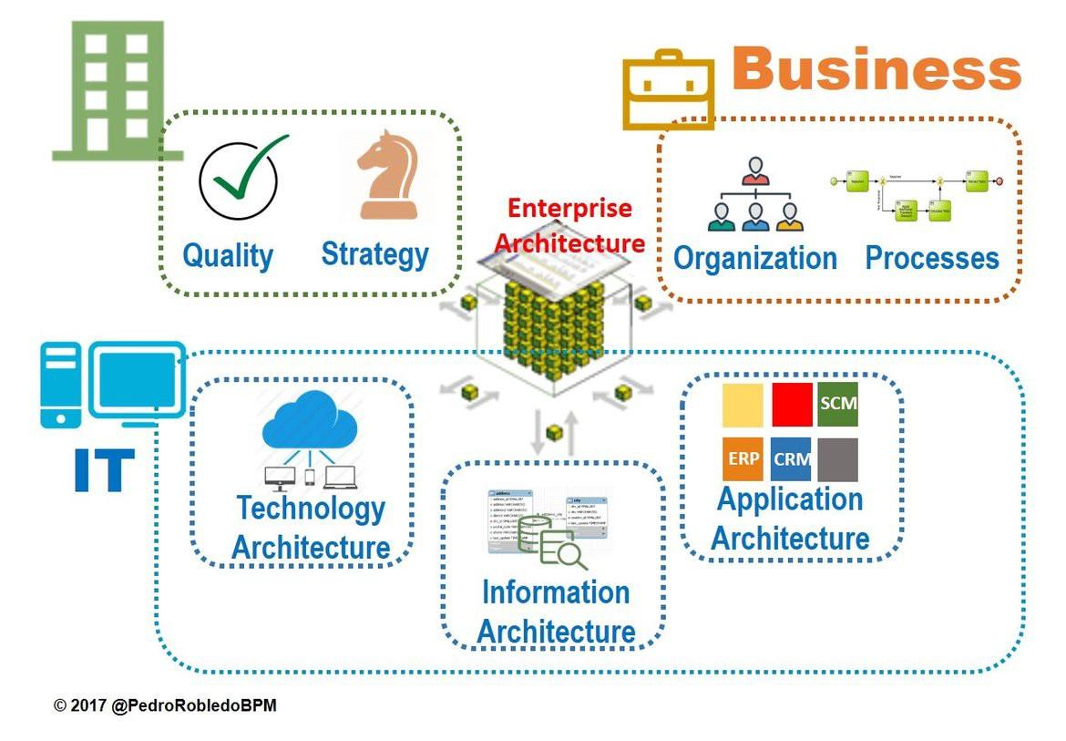
Enterprise architecture
By,
Team SAS
Srivatsav
Anderson
Sankalp

Slide 2
How can Enterprise Architecture be an asset for an organization?
Using IT knowledge/tools in conjunction with business leader's decision making and creating synergies that allow for low cost environment and new revenue streams.
What are the implications for Enterprise Architecture from the advent of modern concepts such as Digital Strategy?
EA will migrate from being focus on data analysis to become a leadership consulting function. By 2022, it is estimated 80% of Enterprise Architects will report directly to business leaders.
How should IS organizations evolve to support the changing role of Enterprise Architecture due to Digital?
Organizations should be more dynamic and willing to think, not in terms of one off projects and teams in silos, but in terms of business problems and whether an IT solution can create value across the company. Eg: AI Automation and Databases.

Slide 3
Thank You !!!!!

Slide 4
Support Slides:

Slide 5
How should
Continuous digital transformation is required as EA should use the latest business and technology ideas to create new revenue streams, services and customer experiences.
As a part digital strategy, EA will need to work closely with business teams. This will position EA as an internal management consultancy, where less time is spent gathering data and more time is spent using data for decision-making purposes.
Modernization in AI will automate most processes to reduce friction and improve business efficiency.
Notes:
https://www.gartner.com/smarterwithgartner/the-evolution-of-enterprise-architecture/

Slide 6
IMPORTANT QUOTE FROM THE ARTICLE
“In other words, you need synergy. An appropriate word to apply to enterprise architecture itself. Enterprise architecture is not about IT serving the business needs. It is about IT and the business working together to turn a company's vision of greatness into reality.”

Slide 7
How can
Enterprise Architecture helps large or growing organizations merge their IT infrastructure with their business goals. This practice promotes the translation of strategies into understandable, clearly defined procedures, processes, and technological requirements. This translation process is considered by many to be EA’s greatest strength.
In today’s complex world of multi-clouds and hybrid clouds, IT systems have become extremely complicated. A well-defined Enterprise Architecture promotes a comprehensive understanding of the entire business and has the potential to show the changes needed for optimizing an organization’s infrastructure.
One of the key aspects of Enterprise Architecture in general and data modeling in particular are the issues of scope and governance. These two interrelated things have a significant impact on the effectiveness of what can be achieved.

Slide 8
What Enterprise Architecture is/does
“In its simplest terms, enterprise architecture is the process of aligning a business's strategic vision with its information technology. It connects different business units for synergistic communication and collaboration, creating a more seamless customer (or end-user) experience.”
Keywords:
Cross Department Synergy (e.g: UPS’s Database Case)

Slide 9
Enterprise Architects are your secret weapon ready to deal with the complexity associated with digital transformation. EAs will establish rules and processes to ensure that your IT landscape is consistent across business units, all while overseeing the entire IT architecture

